Slide 1

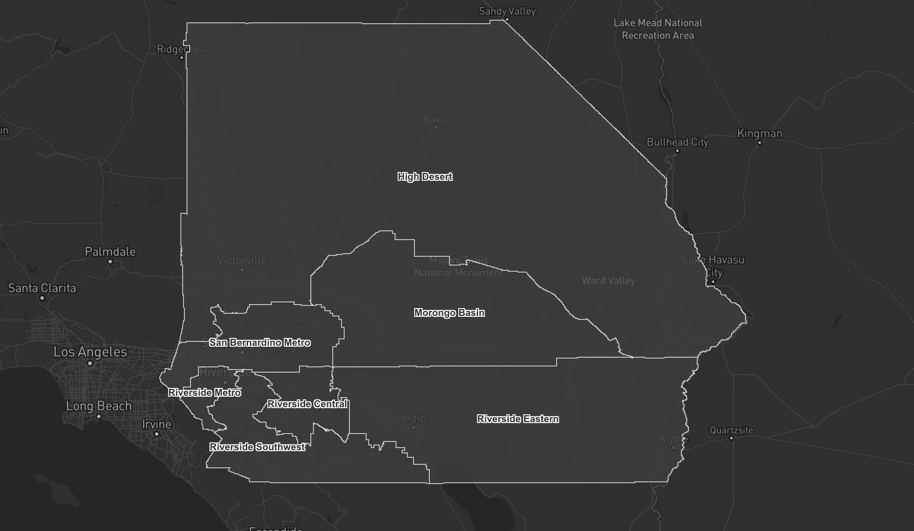
The Use of GIS in
Census IE 2020 Planning
Sunny Shao – CSIUCR

Slide 2
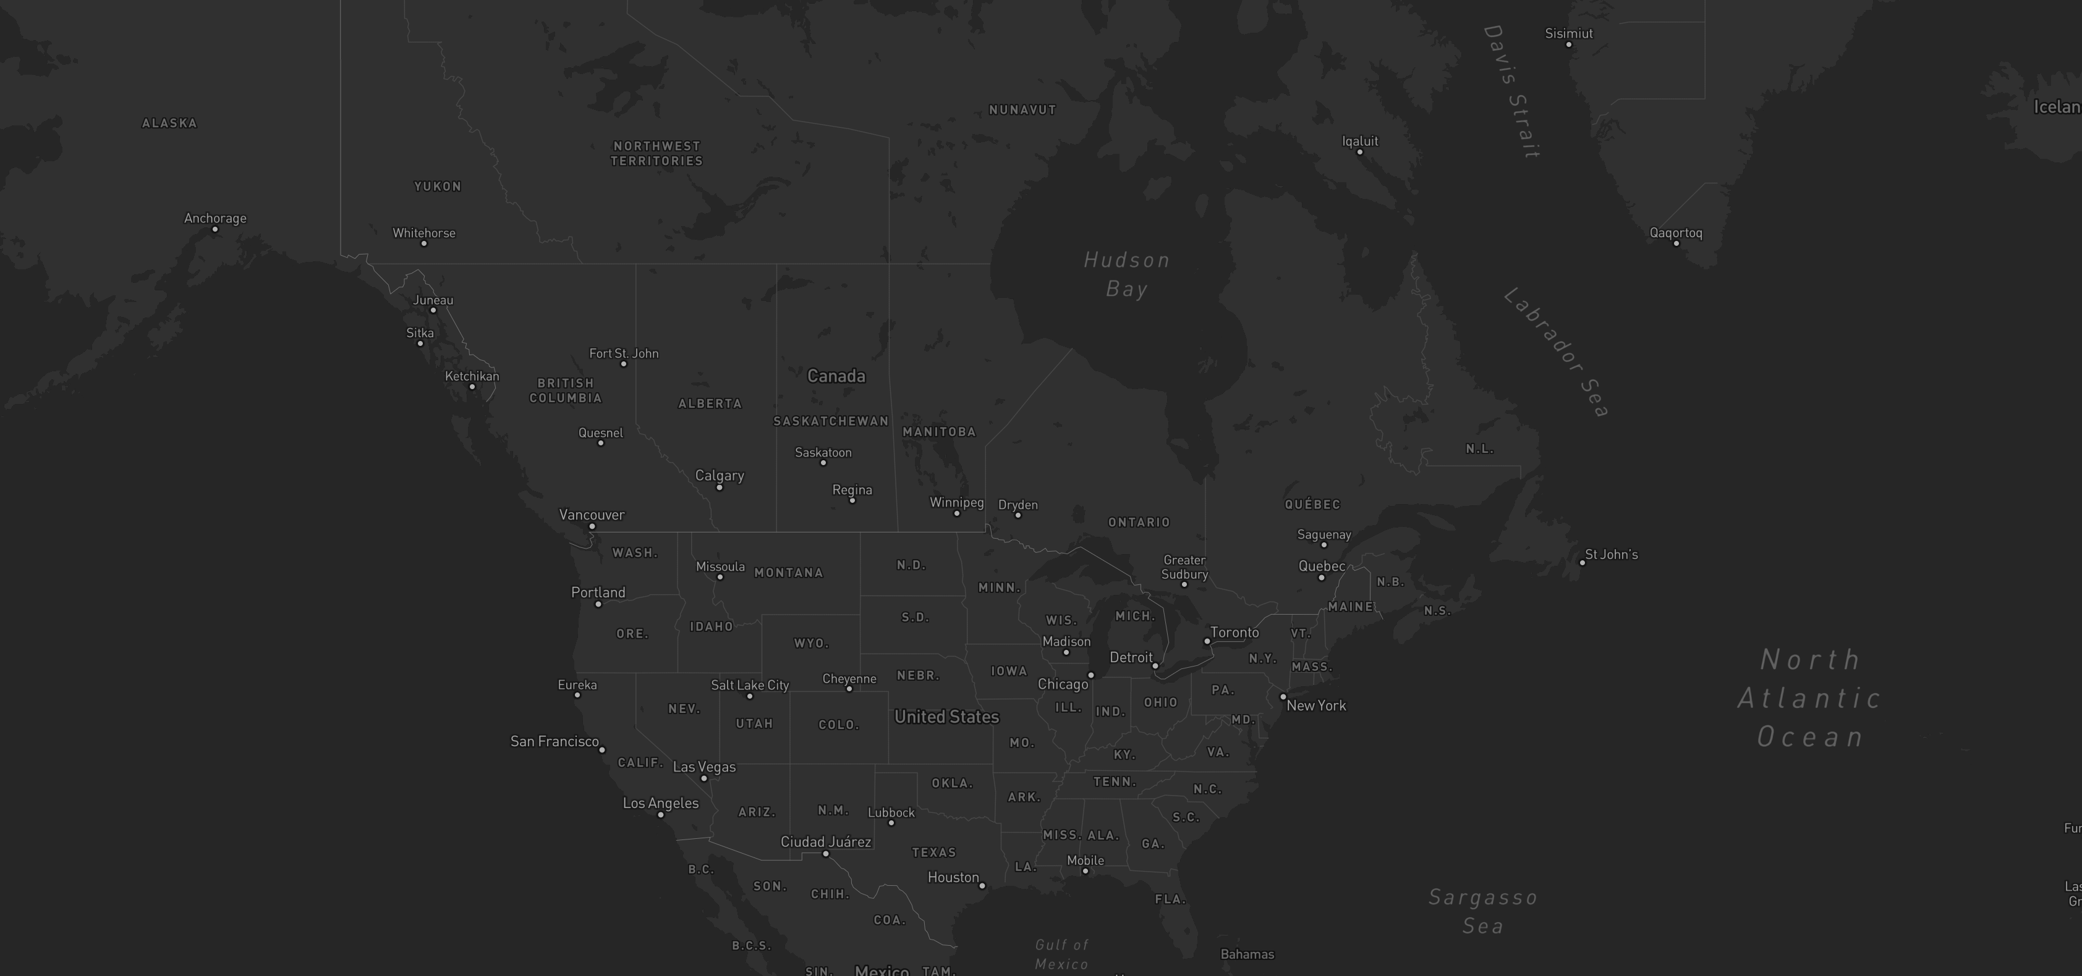
Why the Census matters to everyone?
Determine funding resources for various government programs
Reveal patterns of migration – population shift
Accurate count of the size of CVAP (citizen voting age pop)

Slide 3

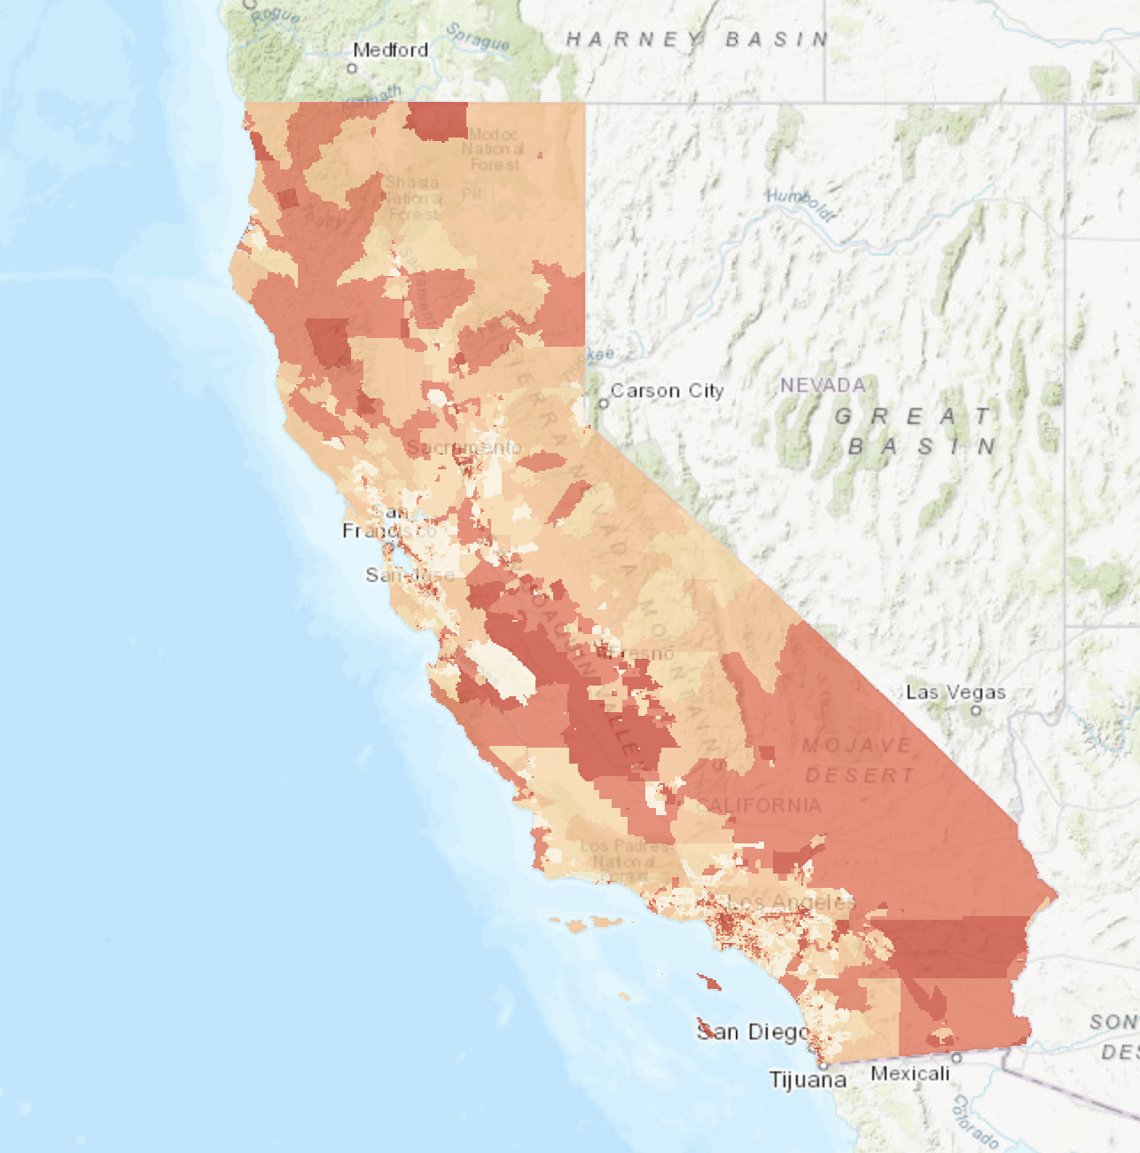
Why the Census matters to the Inland Empire Region?
One of the most Hard-to-Count regions
  LEP households
  Population density
  Renter-occupied units
  Foreign-born Population
  Below 150 percent of poverty level

Slide 4
Hard-To-Count Score
  Nonresponse rate – Census Mail Return
  Sort return rate across tracts
  Score = percentile
  Other factors

Slide 5
Hard-To-Count Score
  Negative Factors (lower mail return rate)
  Age 18-24
  Hispanic
  Renter occupied units
  Female household head/no household head
  Males
  Positive Factors (higher mail return rate)
  Age 65+
  Non-Hispanic white
  Married family households
  Single unit structures
  College graduates
  Different housing unit 1 year ago
  Population density
Sources: 2013-2017 American Community Survey 5-year estimates; CPUC; 2018 Planning Database

Slide 6
Is UCR hard-to-count?

Slide 7

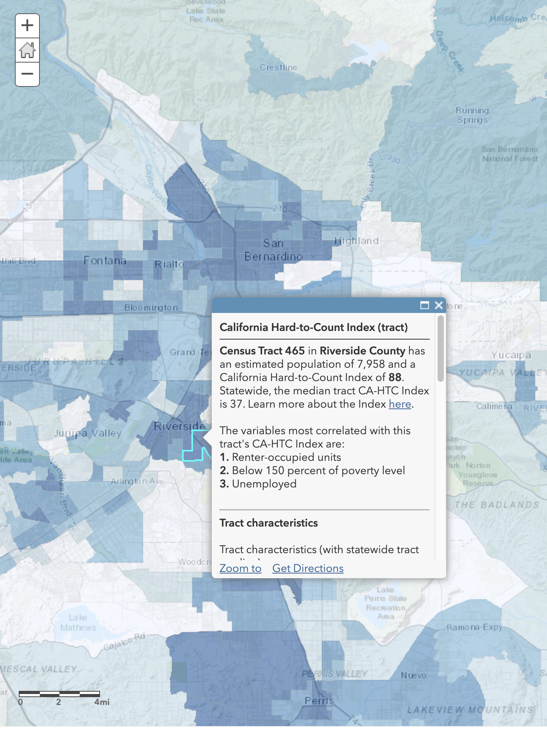



UCR – Census tract 465
  Renter-occupied units
  Below 150 percent of poverty level
  Unemployed
Factor | Estimate
Renter-occupied units | 96.3%
Below 150 percent of poverty level | 62.3%
Unemployed rate | 17.5%
Foreign-born Pop | 22.1%
Moved from outside county in past year | 33.7%
  HTC score = 38.0
  2010 Mail return rate = 66.4%

Slide 8
Compared to other UC Campus
  UC Riverside
  HTC score = 38.0
  2010 Mail return rate = 66.4%
  UC Los Angeles
  HTC score = 14.8
  2010 Mail return rate = 81.2%
  UC Irvine
  HTC score = 30.6
  2010 Mail return rate = 79.9%
  UC Santa Barbara
  HTC score = 30.4
  2010 Mail return rate = 85.7%
Sources: 2013-2017 American Community Survey 5-year estimates; CPUC; 2018 Planning Database

Slide 9
This is the challenge of the entire Inland Empire region.

Slide 11
IE CCC (IE Complete Count Committee)

Slide 12
CSI UCR

Slide 13
  Challenges for Census IE 2020
  Not much prior assets & experiences
  Limited resources
  Limited time
  Complex collaboration through various agencies and organizations

Slide 14
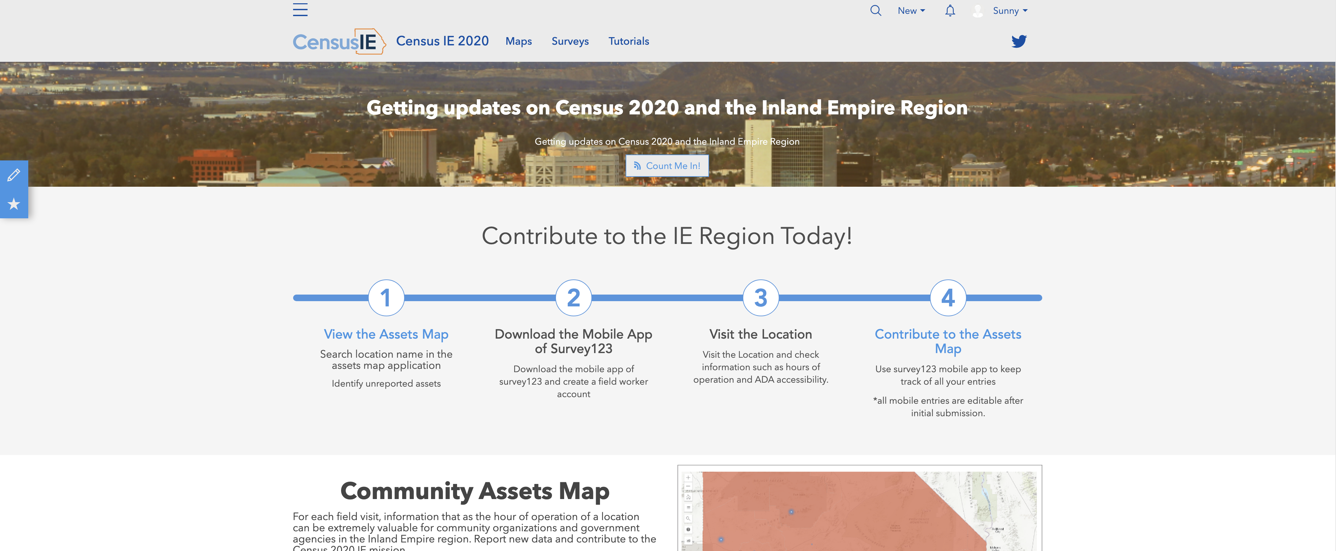
Census IE 2020 Hub

Slide 15
Objectives of the Census IE 2020 Hub
Gather Canvassing insights
Hosting data from different partnering organizations
Inform the public on key processes
Community Assets Survey
Community Assets Map
Landscape Map

Slide 16
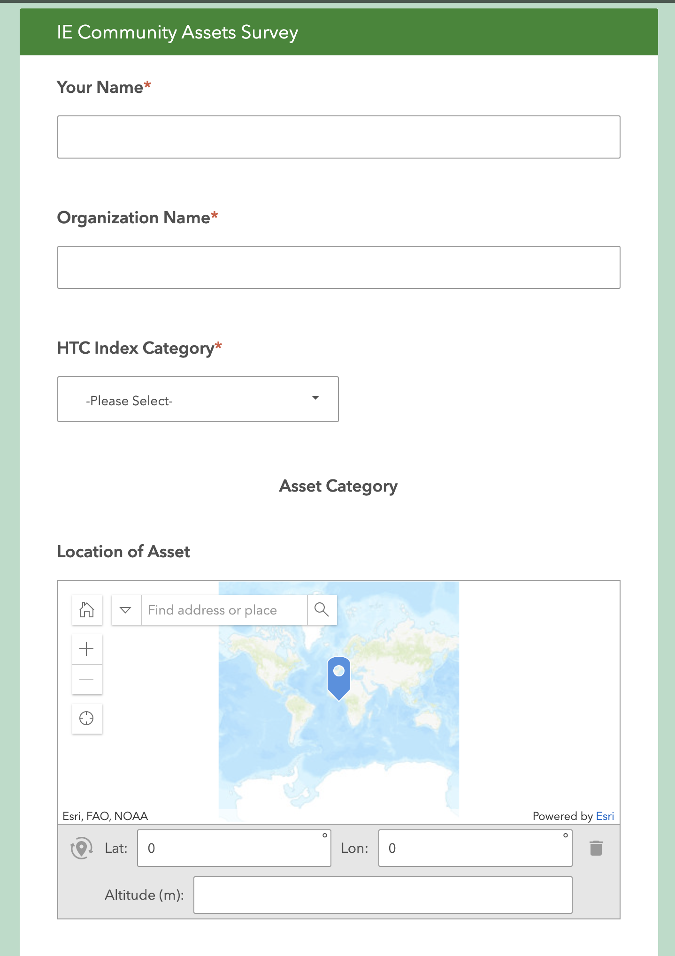
Community Assets Survey
  Location (GPS/Address lookup)
  Days/Hours of Operation
  Services provided
  Language capacity
  Racial/Ethnic Group served
  Parking Spots & Message Board
  Screenshots of the Location

Slide 17
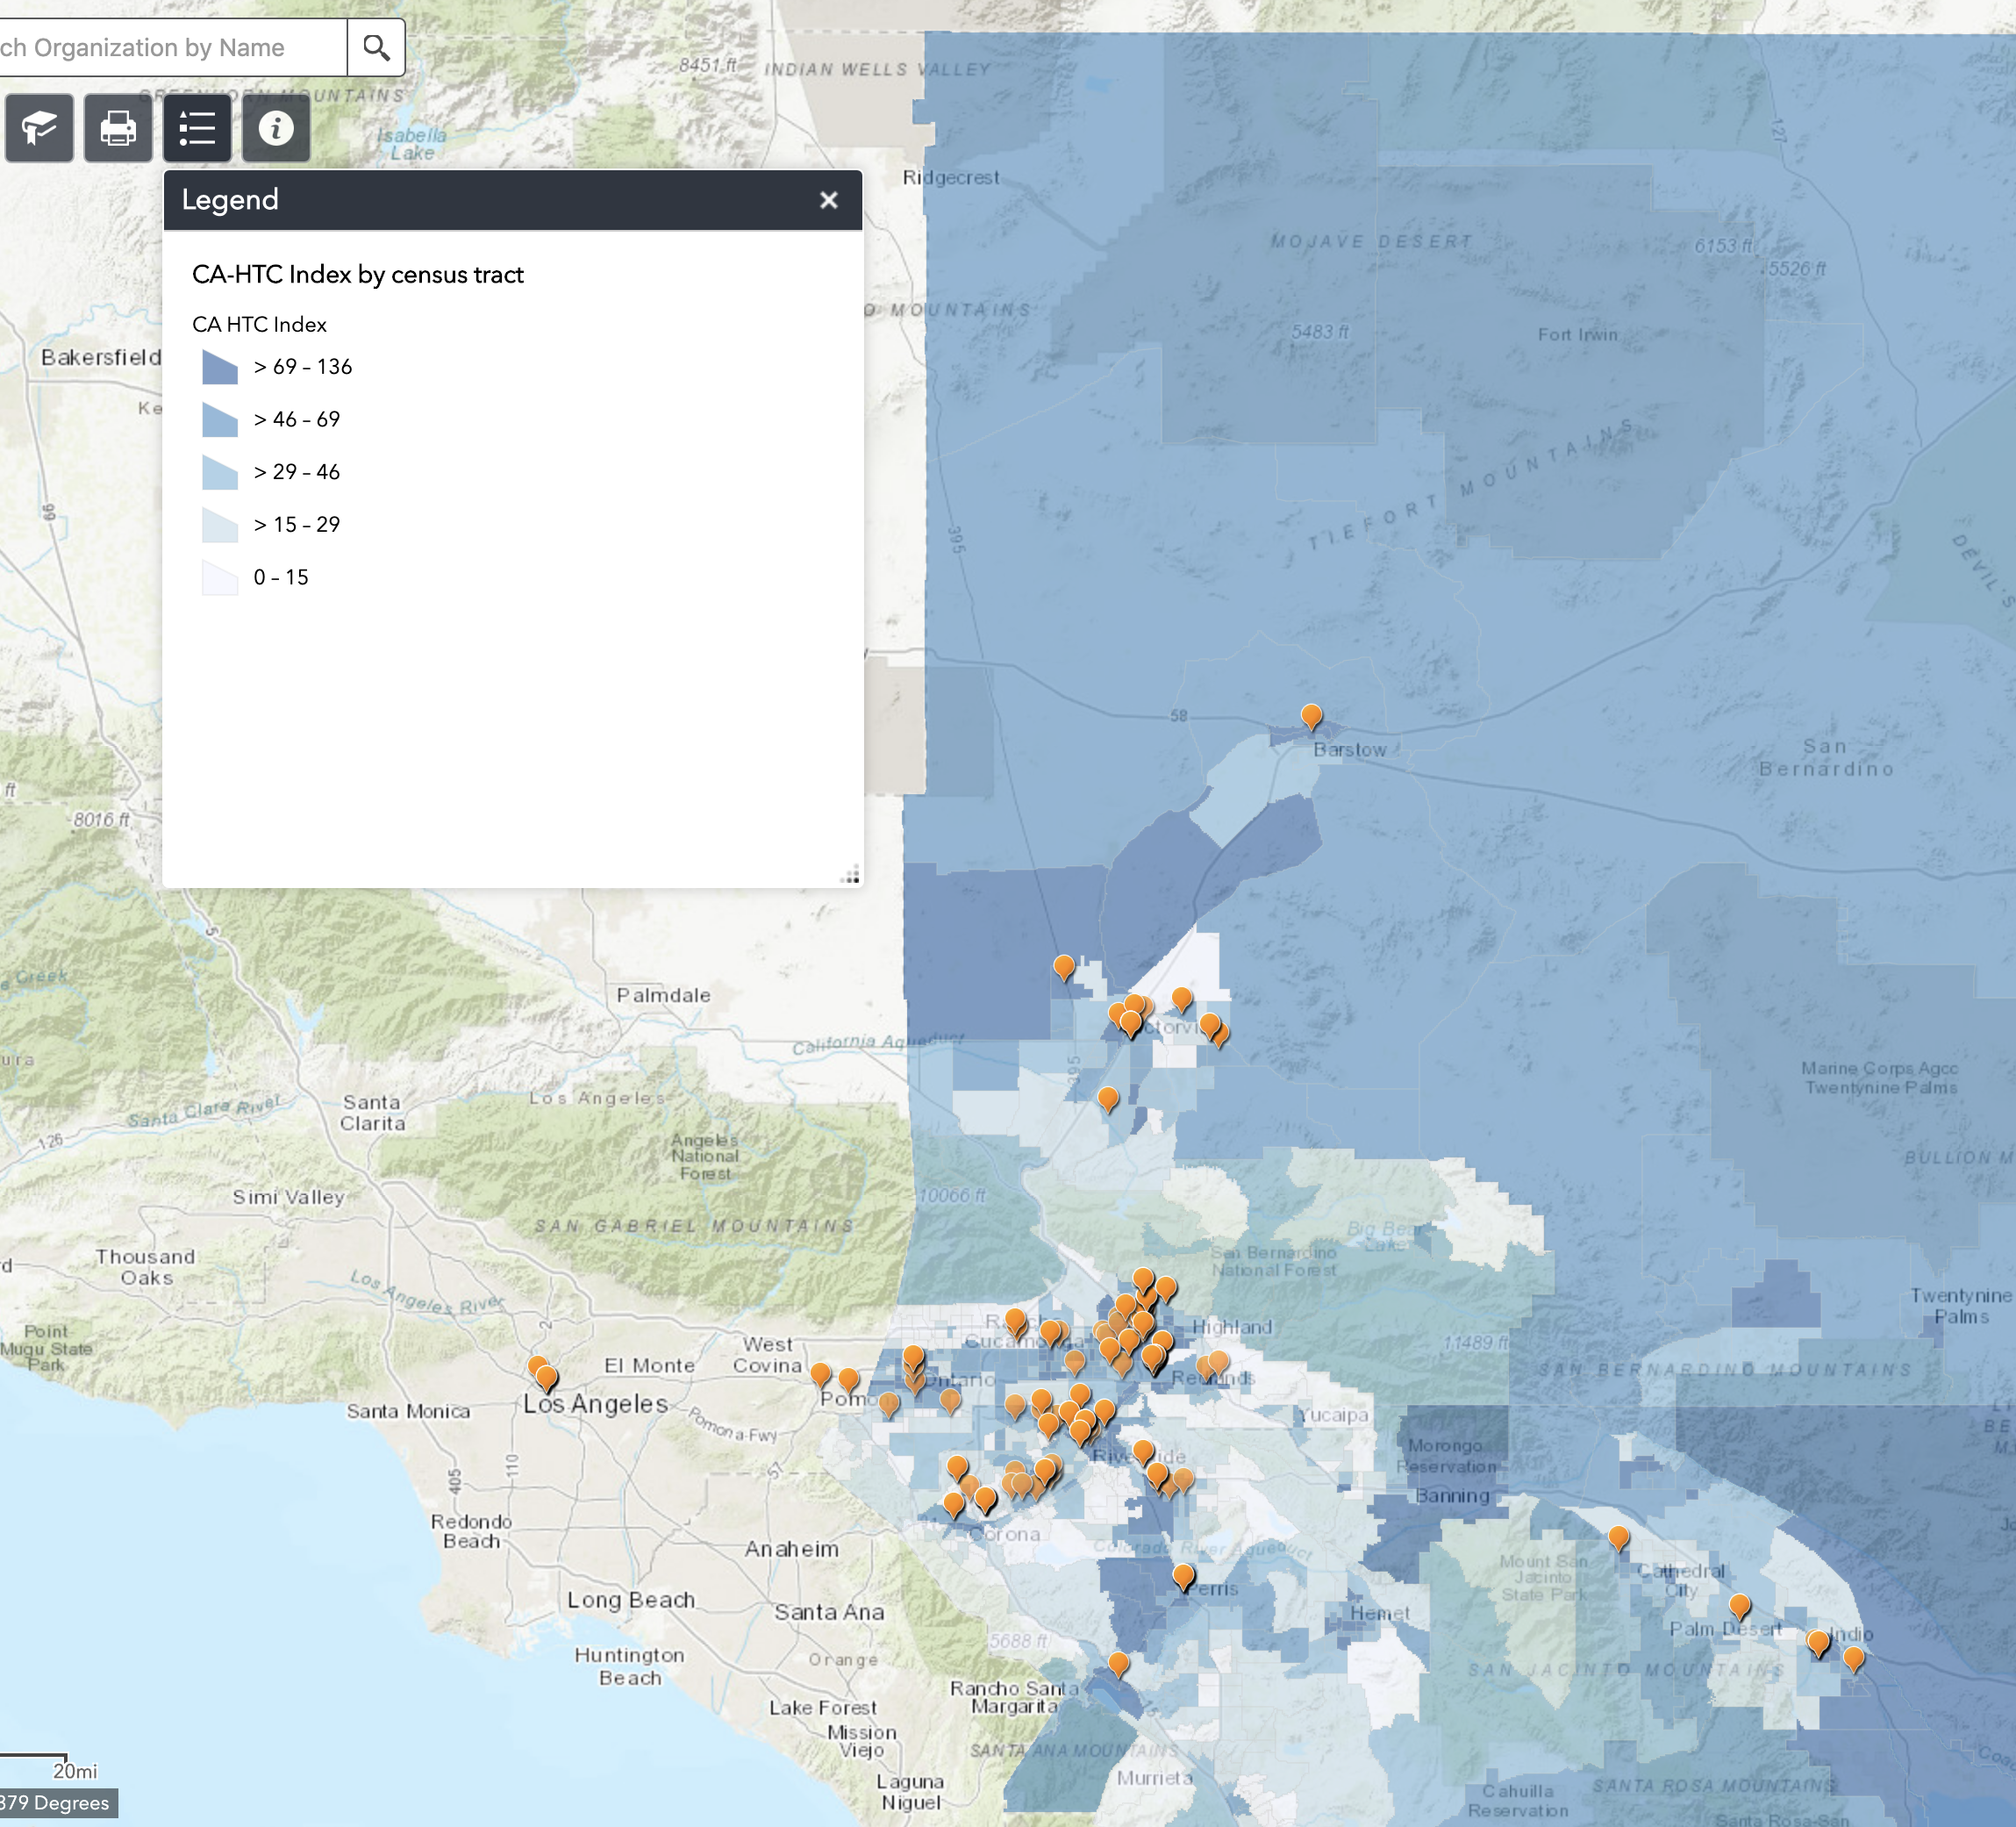

Community Assets Map
  HTC map
  Community assets (gov agencies)
  Community assets (inland empowerment sync)
  ACS data layers
  Landscape Survey Capacity

Slide 18
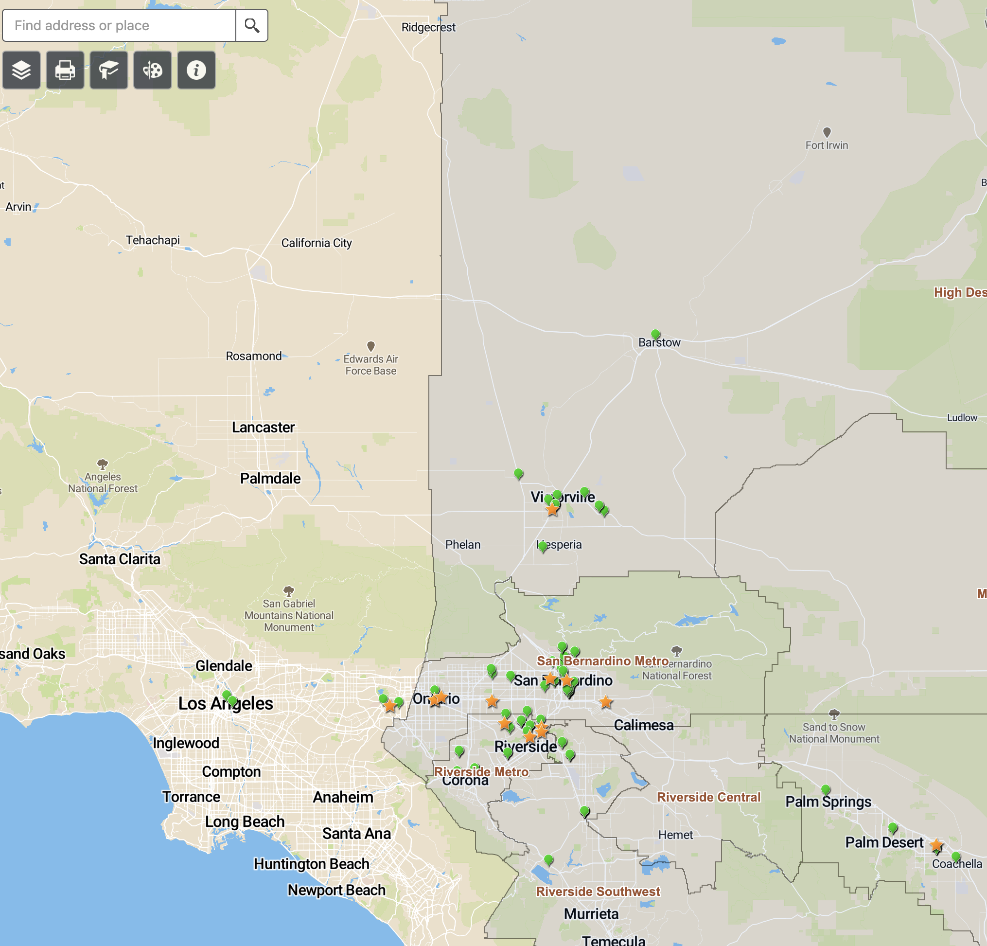

Landscape Map
  Landscape
  Funded orgs

Slide 19
Census IE 2020 Hub
Build experience for census ie 2030
HOSTING VALUABLE ASSETS & SHARE WITH AGENCIES AND ORGANIZATIONS IN THE ie

Slide 20


